Slide 1
Ancient India
By Anju Bala

Slide 2
Introduction:
India’s Geographical Setting:
-Himalayan Mountains are in the North.
Ghats Mountains are east & west.
-India is a sub-continent plateau

Slide 3
-Monsoons (Seasonal winds with rain) hit India.
-India’s two main rivers are; The Ganges & Indus River
- Indus Valley is the cradle of India’s civilization.

Slide 4
The first settlements ca. 3000 B.C.E., when farmers settled along the Indus River in what is now Pakistan.
II. Indus Valley Civilization:

Slide 5
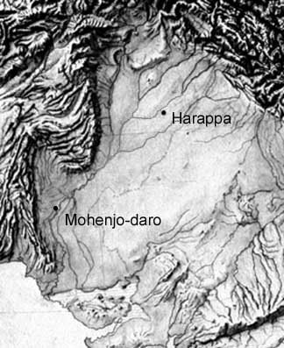
By 2500 B.C.E. the entire region was dominated by two cities called;
Harappa and
Mohenjo-Daro

Slide 6
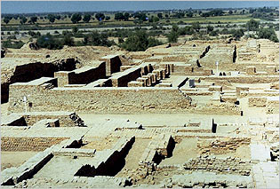
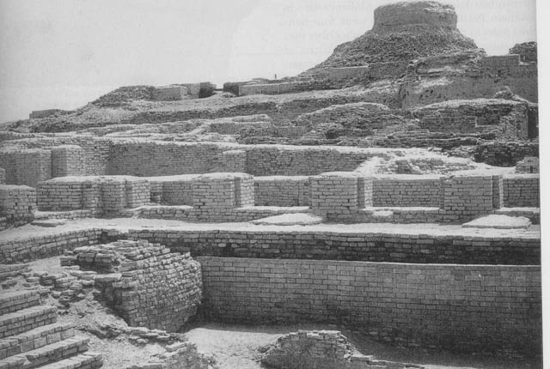
Harappa-Mohenjo Daro

Slide 7
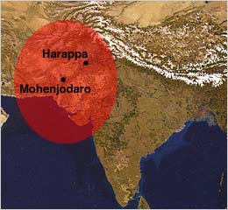
Harappa:
Traded with Iran and neighboring regions in India to the east.

Slide 8
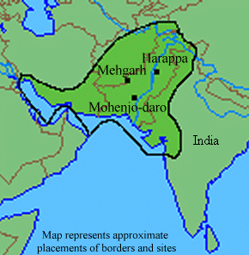
Mohenjo-Daro
Traded with the Persia Gulf and Sumer to the west.

Slide 9
Political
Structure:
Villages & cities were never politically united; however, they did share a common language & culture.

Slide 10
This is very similar to Mesopotamia and China. Region was united only by trade.

Slide 11
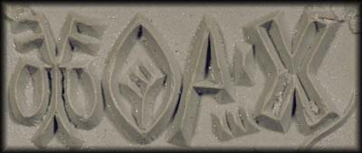
Indus Valley Achievements:
Writing system

Slide 12
Trading Seals
Writing developed from earlier trading seals, which had the merchants name and symbols of trade items.

Slide 13
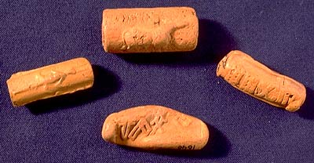
Terra Cotta Trade Seals.

Slide 14
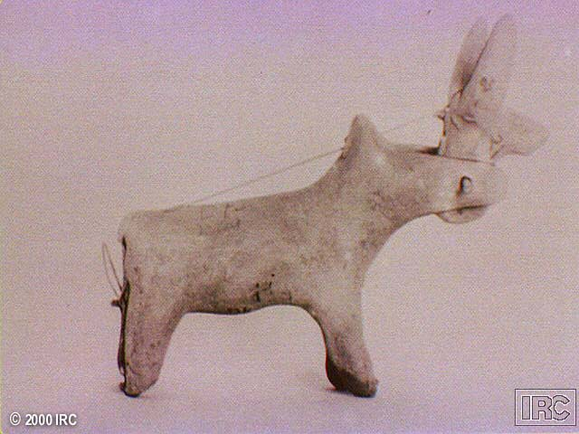
Peaceful items like toys jewelry. (Terracotta toy cow with Moveable head.)

Slide 15
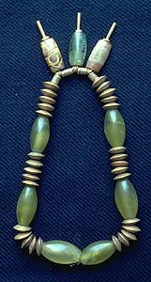
Jewelry made of gold, agate, jasper, and garnets.

Slide 16
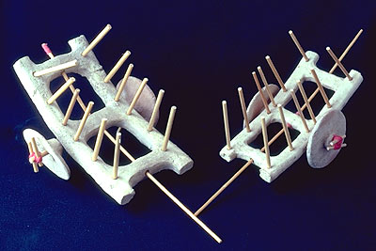
Wheel technology ca. 2300-2200 B.C.E.

Slide 17
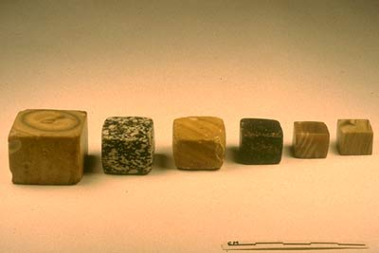
Standard weights and measures based on ratio of 1/16th.

Slide 18
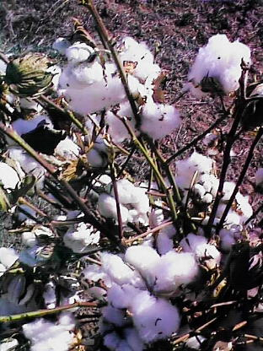
The first civilization to cultivate cotton and make cotton clothing.

Slide 19
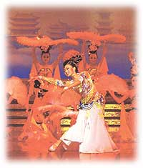
First matrilineal society (female led society.)

Slide 20
Cities had sewer systems; because bathing was an essential part of their religion.

Slide 21
Religious beliefs:
Great Bath Tanks were used for the purification of the body & soul.

Slide 22
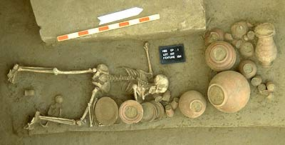
Religion beliefs were centered on the idea of an afterlife, thus bodies were buried with personal items.

Slide 23
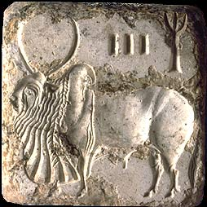
Hump-back bull;
Symbolized leader, whose strength protects the people

Slide 24
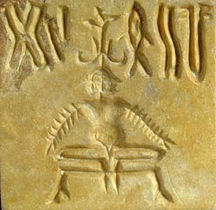
Priest meditated in yogi style to become connected with the gods.

Slide 25
III. Aryan invaders:
Around 1500 B.C.E., the Indus culture were
conquered
by the
Aryans.

Slide 26
The Aryans were a nomadic people who migrated into the Indus Valley from central Asia (Russia.)
They introduced iron and the horse chariot to India.

Slide 27
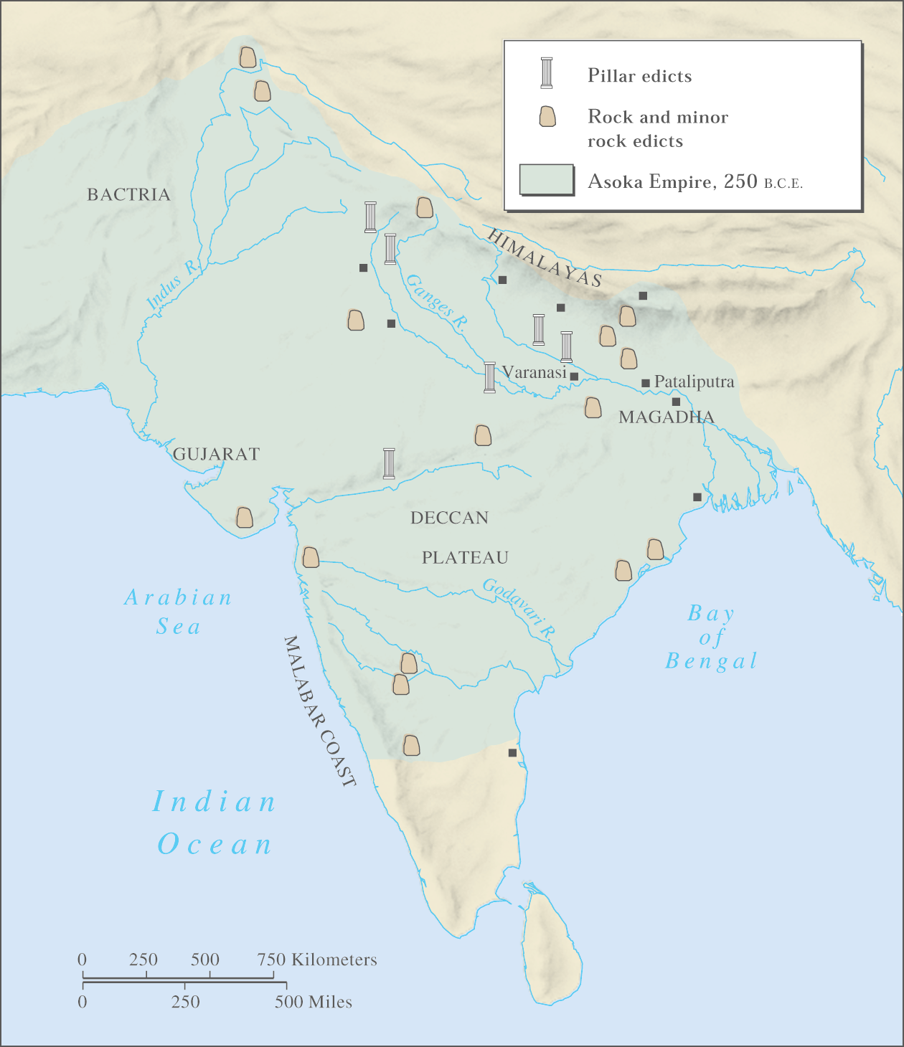
New Aryan Ideas:
A new government system. They had no complex government; only grouped in clans, that were ruled by warrior chiefs called rajas.
©2004 Wadsworth, a division of Thomson Learning, Inc. Thomson Learning™ is a trademark used herein under license.

Slide 28
The Aryan tribes settled in different regions of northwestern India.
The tribes were called Gana (meaning “collection” of peoples).
The chief of each tribe was an hereditary job. He had final say on decision; but had to listen to a committee of the people.

Slide 29
2. A new language (Sanskrit/Hindi); and literature.
The Vedas “Books of Knowledge”:
A collection of poems & sacred hymns, composed around 1500 B.C.E., that describes the beliefs & daily life of the Aryans. The period of 1500 – 1000 B.C.E. is called the Vedic Period.

Slide 30
The Ramayana &The Mahabharata:
Two Aryan epics written around 1000 B.C.E. They are stories about Aryan life, and wars during this period. The period from 1000 – 500 B.C.E. is called the Epic Period.
The Ramayana tells the story in which the (good) king Rama kills the (evil) pre-Aryan king Ravana.

Slide 31
3. A new education system. Children were taught by a guru (teacher). Every student, including the chiefs son, had to obey the guru. All education was rigorous and giving orally.

Slide 32
4. A new marriage tradition. The red dot on an Indian woman’s forehead goes back to the Aryan tradition of having a groom apply a spot of his blood on his bride’s forehead, as a sign of marriage.

Slide 33
5. The Hindu religion to India.
6. A new social organization, called the Caste system.

Slide 34
IV. Hinduism:
- The Origins of Hinduism are unknown, going back to the early Bronze or Neolithic period.
- Hinduism was not inspired by a single individual or event. It is a combination of several religious beliefs, traditions, & gods of ancient India.
-Although Hindu gods are referred to as different aspects of a single deity, Hinduism is still considered the last of the polytheistic beliefs.

Slide 35
Hindu deities:
Brahma, the “Creator”
Vishnu, the “Preserver”
Siva, the “Destroyer”

Slide 36
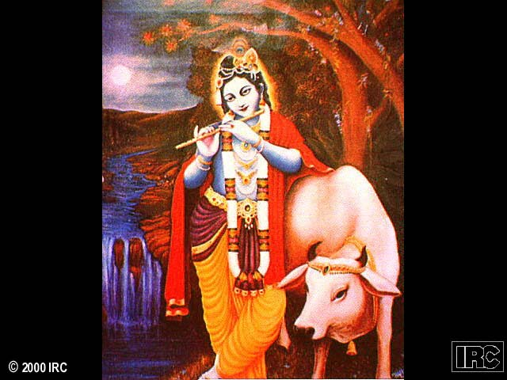
Krishna was the ancient god of the Aryans. He is believed to be an early prince who obtained nirvana.

Slide 37
Fundamental Beliefs of Hinduism:
- There is no set dogma (unquestionable truth) to Hinduism.
- Therefore Hinduism is a religion with a variety of beliefs.

Slide 38
The Upanishads:
- Literature composed between 800 B.C.E. and 500 B.C.E. Written in Sanskrit. It provides several concepts fundamental to Hinduism

Slide 39
Hindu Terms:
Dharma – set of religious and ethical duties to which each creature in the universe is subject
- Karma – the effects of the activities on its atman

Slide 40
- Atman – the soul of each individual
- Samsara – reincarnation, the soul passes through a series of bodies
- Nirvana– release from worldly life and unification with the universal spirit (called Brahman)

Slide 41
Hindu Life Cycle:
- Youth; being educated by a Hindu Guru.
- Householder; leading your family in the ways of Hinduism.
- Reflection; using the teachings in order to break the cycle of bad karma.
Meditation; the atman seeking communion with the universal spirit.
Nirvana; breaking the cycle of life and becoming one with the universal spirit.

Slide 42
- By the 7th century C.E., personal prayer had replaced sacrifice of animals. This led to the building of temples and shrines which housed statues and pictures of gods. Cave are also used.

Slide 43
- Hinduism sped to the places of kingdoms in Cambodia, Vietnam, Indonesia and Thailand. Hinduism is still popular in these areas today.
How Hinduism Sped to Southeast Asia:
Use of military force.
- Culture transmitted through trade.
- Brahmin priests invited by local southeast Asian rulers

Slide 44
V. The Caste System:
- A collection of 1028 verses of poetry, called the “Rigveda” introduces the mythic origins of the caste system. It also provides a rationale for this system.

Slide 45
The Caste System is India’s rigid social stratification based on Religion.
Social division of the Caste System:
Brahmins - Priests/Rulers
Kshatriyas - Warriors
Vaishyas - Merchants
Shudras - Farmers
Untouchables; Non-Aryans

Slide 46
In each Aryan tribe, people belonged to one of the first four groups. In the beginning, these were just occupations. People could move from group to group. This changed as tribes migrated into India. A person’s occupation began to depend on their birth; and, change became difficult.

Slide 47
The Rigveda provided religious justification to the social system and separated people by occupation, and ethnicity. The Caste system became extremely rigid, unequal, and hierarchical. No inter-marriages were allowed between caste divisions. And education was limited to the upper-caste.

Slide 48
Reasons for the caste system:
- It was an attempt by the upper class to freeze the economic system.
It was imposed by a coalition of priests and warrior-kings to maintain control over the local population.
It was created as an alternative to open slavery.

Slide 49
The End.

